Slide 1



Delivering Oral
Presentations
Te Piringa Faculty of Law, 2024

Slide 2

Mooting Information and Education
Introduce yourselves
Read the handbook and mooting rules
Listen to the coaching session

Slide 3
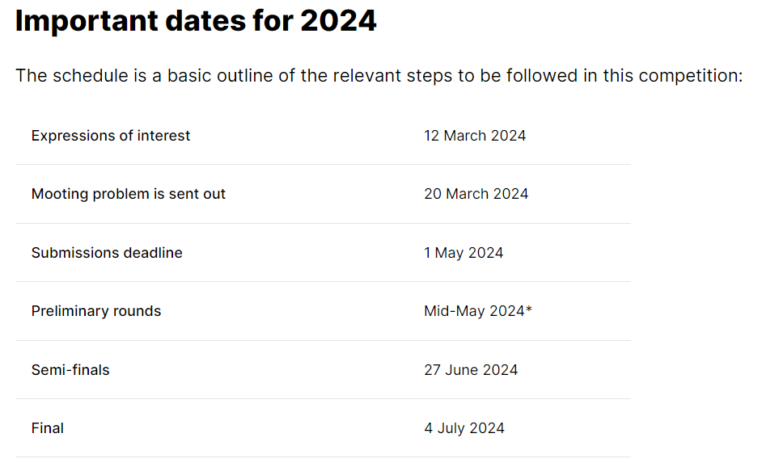
Competition Dates
Semi-finals will take place at the Moot Court on the Waikato Hamilton Campus on 27th June.
Finals will take place at the Hamilton District Court on 4th July.

Slide 4
Mooting Skills – What will you learn?
The process of litigation
Etiquette and procedures followed in Court
The process of legal reasoning
The sources of law in NZ
The principles of legal research
The development of legal argument
Public speaking and presentation skills

Slide 5

History
Te Piringa Faculty of Law is the only New Zealand law school that hosts a secondary schools mooting competition since 2001.
Approximately 40 New Zealand schools participate in an intense competition held over May - July each year.

Slide 6

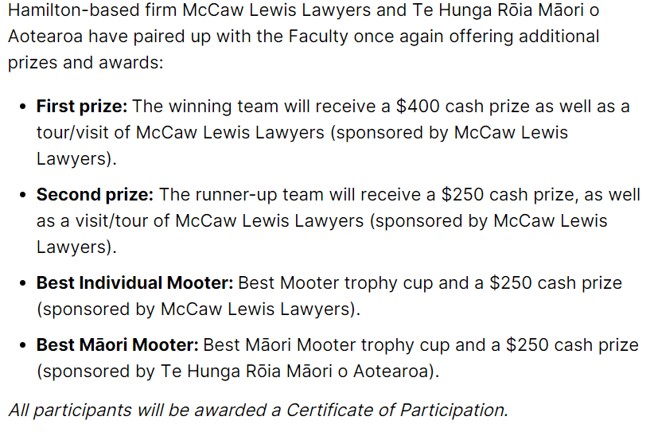
What if we win?

Slide 7
Practical Points
Te Piringa Faculty of Law provides you with fact scenario and materials
You can have a team of two or three but only two can speak – the third member is a researcher and/or reserve
You must restrict yourselves to the facts and research materials provided – you can’t make any up!
Each moot takes about an hour

Slide 8

What if we are far away?
For some teams, due to the distance to travel to Hamilton, we may be able to hold the preliminary rounds in your area/region.
We will keep in communication with teams about this.

Slide 9
Synopsis
Each team must provide a written outline of their submissions (“synopsis”)
It must be in electronic form, and it must be sent by email to lawevents@waikato.ac.nz
Needs to contain outline of team’s argument and who will be arguing what
Synopsis must have a front cover that includes the name of your school, your allocated team number and names in full of all team members
You must abide by your submissions where possible – small departure may be permissible

Slide 10
Oral Presentation
Mooting is about persuading a judge that your view of the law is correct.
You need to understand some legal concepts.
The speaking time limit is 10 minutes for each student with a 3 – 5 minute right of reply.

Slide 11
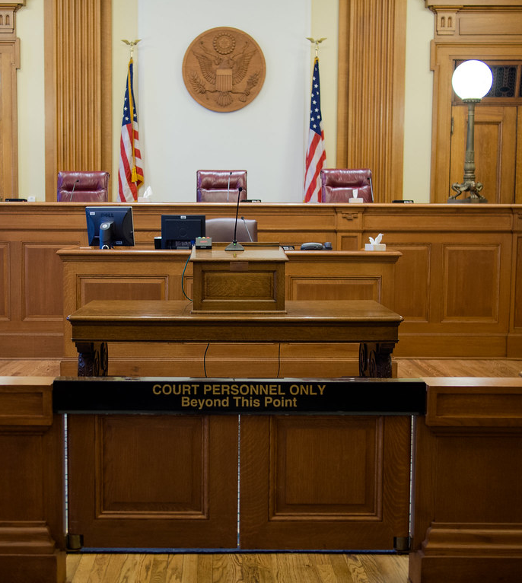
What is the law? Three main sources:
1. Parliament – House of Representatives & Governor General responsible for making laws known as statutes for example The Crimes Act 1961. Used to promote social and economic policies and is mostly a forward planning type of law.

Slide 12

What is the law? Three main sources:
2. The Executive/ Delegated Legislation – Parliament often gives other bodies permission to make laws. It might let a local council make laws about parking or dog control in a particular region. These are called bylaws or regulations.

Slide 13

What is the law? Three main sources:
3. The Courts/Case Law – Judges have to make decisions about who will win a case. They look at the facts and listen to both sides presented by the lawyers. Many decisions made by judges are written down in reports like New Zealand Law Reports.
Judges sometimes have to interpret a statute (which is superior law) and/or abide by decisions made on same or similar facts by courts of higher authority. This is known as the doctrine of precedents.

Slide 14

What is mooting?
Presentation of a moot is an example of legal advocacy.
It is presenting a case on behalf of a client.
It is about persuading the Judge that your argument is the winning one, but you may only do so by reference to the law.

Slide 15
Preparation for Mooting
The oral presentation in court is the tip of the iceberg.
Most of the hard work has to be done before you get there – prepare!
Your mooting problem will outline a series of facts.
It will also include some legal issues and relevant law which could be statute and/or case law and/or delegated legislation.

Slide 16
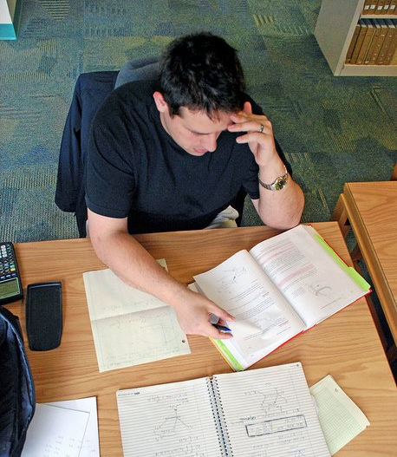
Preparation tips
Read all of the general instructions to work out what has to be done – planning is very important.
Read the moot problem very carefully to get an overview and think about the general facts of the case.

Slide 17
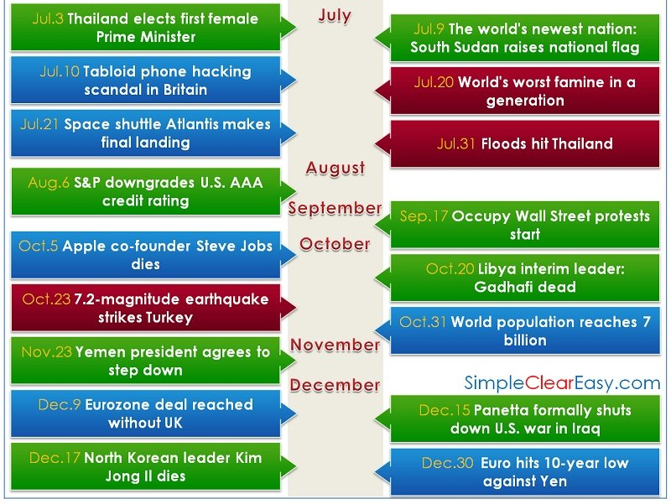
Preparation tips
You must master the facts.
Construct a timeline of the facts from earliest events to latest events.
Next to dates set out the events that took place.
This is known as a chronological timeline.

Slide 18
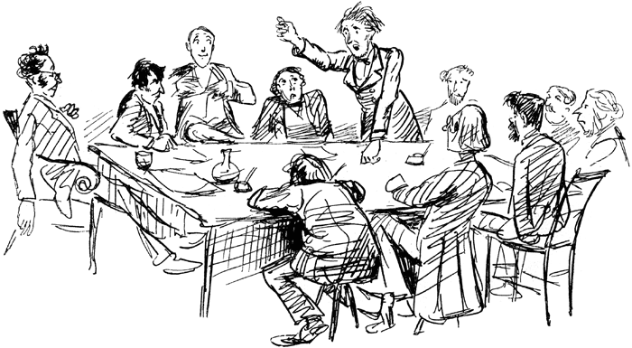
Preparation tips
You then need to master the relevant law.
Your legal issues will be clearly defined for you.
This is what your argument will be about.
Your job is to persuade the judge that the issues should be found in your favour.

Slide 19
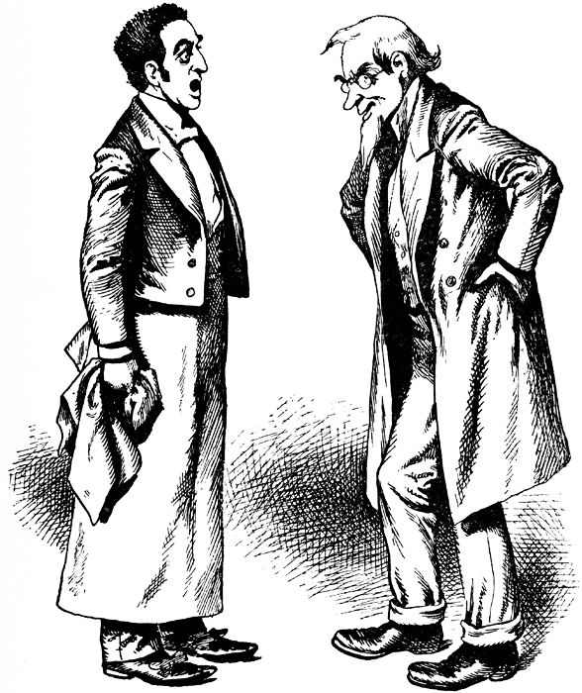
Preparation tips
You will be given all the relevant cases and statute law which is all you will need for your research.
You must draw out points from these materials that support your argument.
Now it is time for a first draft copy of your arguments!
Each team member will have at least one issue to argue.

Slide 20
Speaking Skills
One of the most important skills is public speaking.
Remember you are trying to persuade a judge who is hearing your case for the first time.
Everything you say must be well-structured and clear.
Speak clearly and at a reasonable pace.
All the normal rules of public speaking apply
Your delivery should be clear and at a reasonable pace.
Slow down – don’t rush and don’t talk too quickly.

Slide 21
Speaking Skills
Maintain eye contact.
Your audience is the judge.
Watch the judge for clues about how you are going – does their body language suggest they are following your argument?
Posture – your mum was right!
Stand up straight and keep your hands out of your pockets.
Don’t overuse gesticulation – you want the judge to listen carefully to what you are saying not what you are doing.

Slide 22
Speaking Skills
Speak to persuade.
Be calm and confident.
Don’t be too forceful – judges do not tolerate bullies!
Judges know a lot more than you do but you can disagree if you go about it the correct way.
You should speak up if you think the Judge has gained an incorrect impression of your case.
You can stand your ground in a respectful way.
Don’t pursue a hopeless case – move on to your next argument.

Slide 23
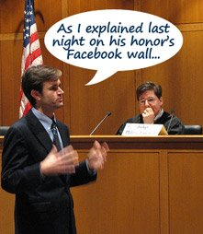
Speaking Skills
Note the time as timing is very important
You only have 10 minutes for your presentation.
Some of this will be taken up with questions from the Judge.
You should be able to make your entire case in 7 – 8 minutes.

Slide 24

Writing the Synopsis
What is it?
It is the document that sets out your written submissions which are the points you raise in support of your argument – see the Mooting Competition Handbook for an example.

Slide 25
Writing the Synopsis
You must include:
  A cover page with the name of your case, your school, your full names & whether you are the appellant or the respondent
  Use one and a half times spacing
  Use 12-point font
  Use a five-centimetre left hand margin
Put case names and books and/or text names in italics
Use bold and/or capitals for emphasis and headings, rather than underlining

Slide 26

Writing the Synopsis
Number each page except the cover
Number your paragraphs and use tabulated subparagraphs where appropriate to make your submissions visually attractive and easier to follow.
Be consistent and logical in your formatting processes.

Slide 27
Legal Issues
Te Piringa Faculty of Law will identify the legal issues for you.
You must cite all cases that relate to your argument – the ones that support it and the ones that don’t support it and say why they don’t apply in this case.
Be fair when dividing legal issues between counsel (which is your mooting buddy).
Don’t give one counsel all the strong arguments and leave others to do their best with the weaker arguments.

Slide 28
Format of the Synopsis
Don’t forget that the synopsis provides the judge with the material facts, the submissions and a conclusion.
Remember to study the example of a synopsis set out in the Mooting Handbook.
In your synopsis, you must:
Relate all your legal submissions to the material facts, and
Cite all authorities in support of your argument, and
Set out in full any statutory provisions or quotations relied on.

Slide 29
Reading a Case
A reported case (“judgment”) is normally set out as follows:
At the very top of each page is the name of the court in which the case was decided i.e. High Court.
Underneath this is the name of the case. Cases are named after the parties involved i.e. Smith v Jones.
Beneath the name of the case is the name of the court along with the place where the Court sat i.e. High Court Hamilton. The dates on which the case was heard are set out together with the names of the judge/s.

Slide 30
Reading a Case
After this there is a list of key words that provide you with some idea of what the case is about.
After the key words, there is a headnote which provides a more detailed summary about the case.
After the headnote, there is a list of other cases mentioned in the judgment. The rule of precedent means the Judge/s rely on past cases to reach their decision.

Slide 31
Reading a Case
Next there is the procedural history that tells you where the case has been before it reached this court. For example, it might have been heard in the District Court and appealed to the High Court.
After the procedural history there is a list of lawyers involved in arguing the case.
After the list of lawyers, there is a word for word report of the Judge/s decision.
Law always involves lots of reading!

Slide 32
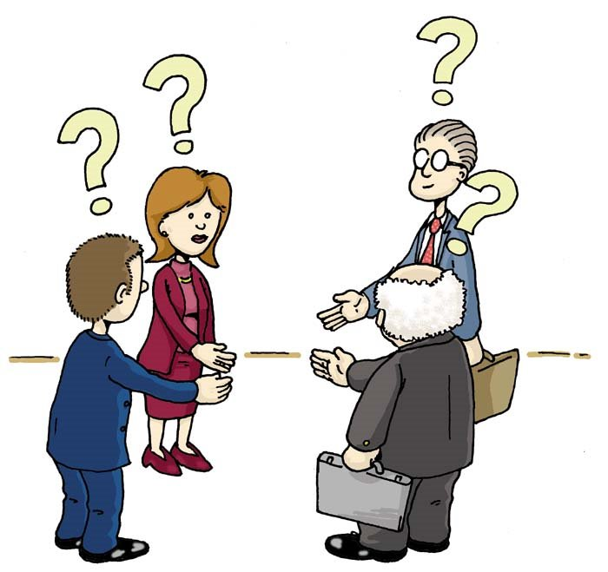
Court Proceedings – How does it work?
The Court has a well-established set of conventions which dictate the way people address each other in Court, the order in which people speak and the manner in which submissions are made.

Slide 33
Court proceedings - Introductions
When everyone is ready the court clerk will announce the Judge is ready to enter by saying “Please stand for His/Her Honour” everyone must then stand.
While everyone is standing the Judge enters and bows. All counsel (mooters) must bow their heads to the Judge.
When the Judge sits down, the rest of the court can sit down.
The court clerk will then announce that the court is in session and will give the name of the case.
The courtroom is a formal setting and appropriate conduct is expected at all times.

Slide 34
Court proceedings - Appearances
Senior counsel for each team introduces his/her team. All members of the team must stand while these introductions are given.
Counsel for the appellant goes first.
You say, “May it please Your Honour, my name is Smith and I appear for the appellant with my learned friend Miss Jones.”
If you are a man – only use your surname.
Women need to tell the Judge how they prefer to be addressed i.e. Miss, Mrs, Ms, Dr.
Senior Counsel for the respondent then follows in a similar fashion.

Slide 35
Court proceedings - The Moot
When the Judge indicates that s/he is ready, counsel for appellant proceeds with the case.
Both counsel for the appellant speak, followed by both counsel for the respondent.
At the conclusion of the second respondent’s 10 minute presentation, they then exercise their right of reply. After that, the appellant will have their 3–5 minute right of reply.
Remember to speak clearly and slowly so the Judge follows everything you say.

Slide 36
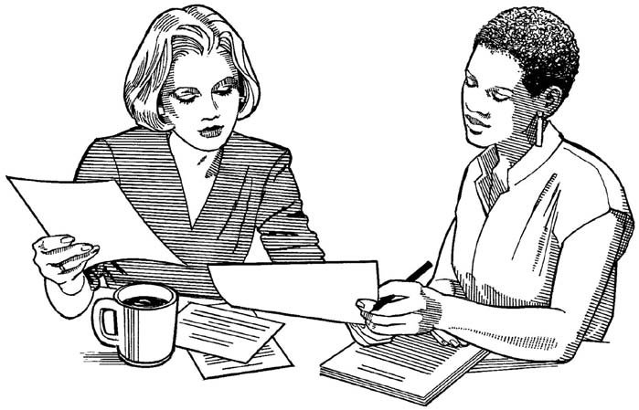
Synopsis containing written submissions
These must be submitted by the due date so that copies can be made for your opponents.
Remember the cover
sheet must have your names, names of school, name of the case and who you are acting for – appellant or respondent.

Slide 37
Written Submissions
Focus on central issues and the strongest arguments
Organise your material logically and sequentially with your strongest argument first.
Use authorities appropriately – know the difference between binding cases and persuasive cases – know what the hierarchy of courts means.
Avoid lengthy quotations – try to paraphrase the principle the case stands for.

Slide 38
Written Submissions
Cite and distinguish adverse authorities –don’t ignore material that doesn’t support your argument – you need to try to distinguish it from your case in a way that supports your submissions.
Ensure you give correct and complete citations.
Get to the point quickly, in as few words as possible using plain language.
Aim for accuracy, brevity and clarity.
Check your document for spelling and grammatical errors – these make a huge impact on the overall document.

Slide 39

Oral Submissions
Remember that some of your 10 minutes will be taken up with questions from the Judges.
It is better to have a few clear, well thought out and well-argued points than galloping though a large number of half formed arguments.

Slide 40
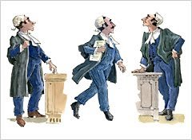
Oral Submissions – Guidelines for Presentation
Focus on critical issues.
Deal with issues in order of importance – make your best points early.
Address each issue in turn and proceed logically and sequentially.
Prepare a self-contained argument for each issue.
Give the court directions as you proceed.

Slide 41

Oral Submissions – Guidelines for Presentation
Have your materials organised. Flipping through pages can be very distracting!
Don’t just read from your submissions – talk to and with the Judge/s.
Confidence can only be attained through good preparation and knowing your case very well.

Slide 42
Oral Submissions – Guidelines for Presentation
Think about whether bringing in a complete script is the best option – it usually isn’t.
Be heard – speak clearly and loudly enough for the court to hear you.
Maintain interest by varying your pace, tone and manner.
Speak slowly and punctuate your delivery with pauses to provide time to think.
Avoid distractions such as flicking your hair/clicking a pen.
Have conviction in your argument but know when to concede.

Slide 43
Oral Submissions – Guidelines for Presentation
Make sure your tone is courteous, polite and conversational.
It is a Moot Court of Law not an opportunity to win an Oscar.
Adhere to the formal speaking requirements of a courtroom. You don’t greet or thank the Judge.
Do not personalise your submissions – avoid phrases such as “I think”, “I feel” or “in my opinion”. The correct term is “I submit” or “in my submission”.
Know your ethical obligations – you must not misstate the law or the facts, exaggerate or ignore relevant precedents. This would breach your professional duty as an officer of the court.

Slide 44
Court Etiquette and Formalities
Stand up when Judge enters room.
When the Judge bows – you bow back.
When Judge sits – you sit.
Senior counsel for appellant is first to go.
Always stand when addressing the Judge and wait until the Judge is ready before speaking.

Slide 45
Court Etiquette and Formalities
Appellants introduce themselves first then the Respondents do the same
When the moot starts refer to other member/s of your team as “my senior/junior counsel” and member of the opposing team as “counsel for the appellant/respondent” or “my learned friend Mrs Brown”
Never use first names for anyone in Court.
Judges are always referred to as “Your Honour” or “Sir” or “Ma’am” (pronounced Marm)
Statements from the Judge to you should receive the appropriate response: “As Your Honour pleases” – you never thank a Judge.

Slide 46

Citing cases and Judges’ titles
Citing a case – example:
Smith v. Jones [1988] 2 NZLR 389
You say: “Your Honour I wish to refer to the case of Smith and Jones, decided in 1988,
which Your Honour will find in
volume 2 of the New Zealand Law
Reports at page 389”
District Court Judges referred to as
“Judge Connell”
High Court Judges referred to as
“Justice Heath”

Slide 47
Questions from the Bench/Judge
Make mooting unique and can produce concern and anxiety in prospective mooters.
No two Judges are the same in the sorts of questions they will ask.
Try to strike a balance between flexibility to respond and remembering the points you want to convey.
Don’t assume the questions are a challenge to your position – it means the Judge is interested in what you have to say.
Use the law and your advocacy skills to persuade the Judge with your answer.

Slide 48
Questions from the Bench/Judge
Listen carefully to the question, pause to consider and if you don’t understand ask for it to be repeated e.g. “I am not sure I understand Your Honour’s question”.
“Think and Drink” – take a sip of water while you consider the answer but don’t use pause tactics too much.
Prepare for predictable questions such as:
  “What were the facts of that case?”
  “What is your authority for that statement?”
Never tell the Court you will get around to answering that later.
Try to adopt a conversational tone and manner.

Slide 49
Questions from the Bench/Judge
If the question is dealt with in your next submission you could say
  “Your Honour, that question is addressed in my next submission. If the Court turns to paragraph 1.3 you will see that I submit that...”
If you don’t know the answer, say so: “Your Honour I cannot assist the court on that point.”
If you think the Judge in unreceptive to your line of argument, you may be best to move on to another point.
Don’t personalise answers and answer with conviction

Slide 50
Useful Responses to Know
If you wish to disagree with the Judge start with “With respect, Your Honour...”
If you believe you have answered as fully as possible say “I appreciate what Your
Honour is saying, but counsel
is unable to assist further”

Slide 51
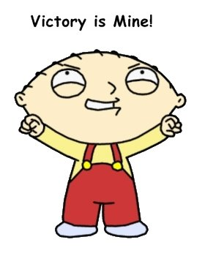
Concluding
When senior counsel finishes, they say “May it please Your Honour, that concludes the submissions for issues [1] and [2]. My junior counsel with now deal with submission [3].”
When junior counsel finishes, they say “If I can be of no further assistance, that concludes the appellant’s/respondent’s submissions”

Slide 52
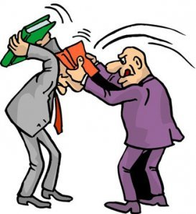
Right of Reply
Should last 2–3 minutes
Purely for rebuttal
Can’t introduce new material
Extract two or three central points in the opposing case and “hammer them home”

Slide 53

All the best!
Have fun learning new skills
Meet new people and build networks for the future
As with anything, you will get out of the moot what you put into it

